Slide 1
Document Owner: Pavan Sai Pakkela Contributor: Supraja & Shashank Peer-Reviewer:Supraja
SWIFT RAILS

Slide 2
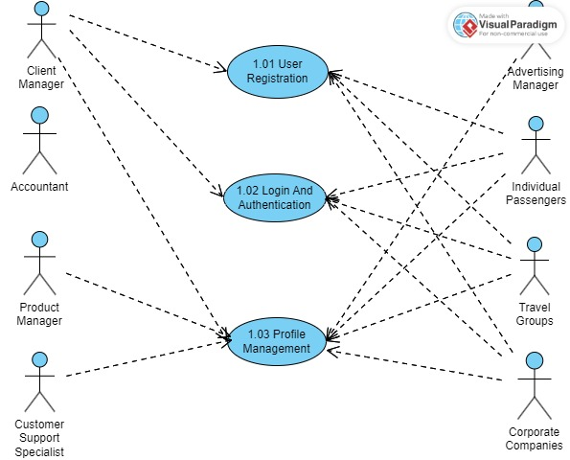
Use Case Diagram
Swift Rails
Module-1: Account Management

Slide 3
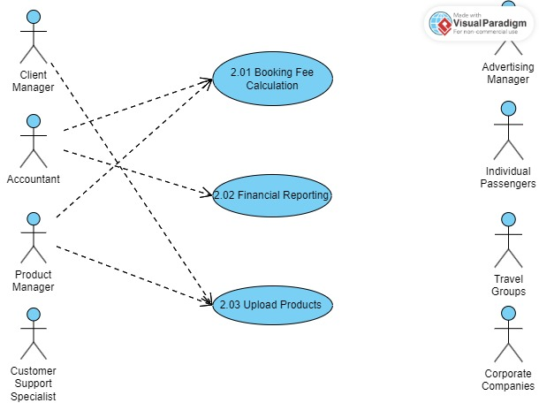
Swift Rails
Module-2 Finance Management
Use Case Diagram

